Slide 1
Object-Oriented Programming
WEEK 03 Abeeha Sattar

Slide 2
Classes v/s Structures
The default access modifiers:
Private in classes
Public in structs

Slide 3
How are struct different in C++?
struct Car {
string direction;
int speed;
void turn(char dir) {
if(dir == ‘r’)
direction = “right”;
else if(dir == ‘l’)
direction = “left”;
}
};
You can add functions to structs in C++!!
You don’t have to use the struct keyword before your struct name when creating a variable!
E.g. Car c; ← This declaration is valid!
Notes:
int main() {
Car c;
c.turn(‘l’);
}

Slide 4
Constructors
A constructor is a member function of a class that has the same name as the class.
A constructor is called automatically when an object of the class is declared.
Constructors are used to initialize objects.
A constructor must have the same name as the class of which it is a member.
Problem Solving with C++ (chapter 10)

Slide 5
How are constructors different from member functions?
They have the same name as the class
They don’t have a return type
They are called automatically when you create a class object
Compilers usually create a default constructor if we haven’t declared any constructors
Notes:
If we end up making any parameterized or copy constructor then its necessary to make a default constructor ourselves.
Otherwise this might lead to errors.

Slide 6
Types of Constructors
Default Constructor
A constructor without any arguments (aka, without any parameters)
Parameterized Constructor
A constructor that can accept arguments/parameters
The parameters are used to initialize the object
Copy Constructor
A constructor that initializes an object by using another object of the same class
It copies the values from the other object

Slide 7
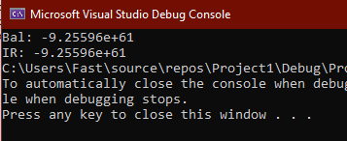
Default Constructor – if not declared…
class BankAccount {
private:
double balance;
double interest_rate;
public:
void showDetails() {
cout << "Bal: " << balance << "\nIR: " << interest_rate;
}
};
int main()
{
BankAccount b;
b.showDetails();
}

Slide 8
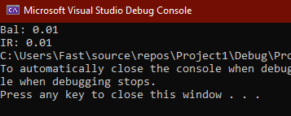
Default Constructor
class BankAccount {
private:
double balance;
double interest_rate;
public:
BankAccount() {
balance = 0.01;
interest_rate = 0.01;
}
void showDetails() {
cout << "Bal: " << balance << "\nIR: " << interest_rate;
}
};
int main()
{
BankAccount b;
b.showDetails();
}

Slide 9
Default Constructor
Compilers provide a default constructor implicitly
You may not see it, but they exist
A constructor is necessary to create an object!
What happens if you make a constructor private?

Slide 10
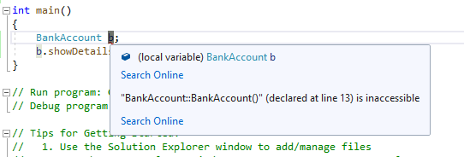
What happens if you make a constructor private?
class BankAccount {
private:
double balance;
double interest_rate;
BankAccount() {
balance = 0.01;
interest_rate = 0.01;
}
public:
void showDetails() {
cout << "Bal: " << balance << "\nIR: " << interest_rate;
}
};

Slide 11
Parameterized Constructor
When an object is declared in a parameterized constructor, the initial values have to be passed as arguments to the constructor function
They can be called implicitly or explicitly.
There can be multiple constructors in a class – This is Constructor Overloading
There can be multiple parameterized ones as well!

Slide 12
Parameterized Constructor
class BankAccount {
private:
double balance;
double interest_rate;
public:
BankAccount() {
balance = 0.01;
interest_rate = 0.01;
}
BankAccount(double _balance, double _interest_rate) {
balance = _balance;
interest_rate = _interest_rate;
}
void showDetails() {
cout << "Bal: " << balance << "\nIR: " << interest_rate;
}
};
Parameterized Constructor

Slide 13
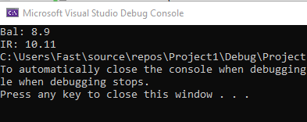
Parameterized Constructor – How to Use
Implicitly:
int main()
{
BankAccount b(8.9, 10.11);
b.showDetails();
}

Slide 14
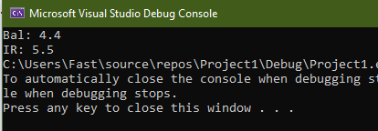
Parameterized Constructor – How to Use
Explicitly:
int main()
{
BankAccount b = BankAccount(4.4, 5.5);
b.showDetails();
}

Slide 15
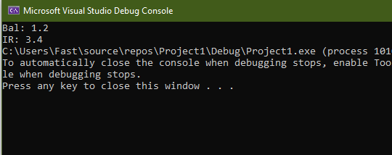
Parameterized Constructor – How to Use
Explicitly | Dynamic Memory Allocation:
int main()
{
BankAccount *b;
b = new BankAccount(1.2, 3.4);
b->showDetails();
}
(->) is an “arrow” operator
We use it instead of the dot operator when we have pointers to a class

Slide 16
Constructor Overloading in C++
Just like normal member functions, constructors can be overloaded as well!
We’ve already seen this being done in our previous example
Default Constructor: BankAccount()
Parameterized Constructor: BankAccount(double _balance, double _interest_rate)
See how they have the same names but different arguments?
You can have as many overloaded constructors as long as they have a different parameter list!

Slide 17
Overloading Parameterized Constructors
class BankAccount {
private:
double balance;
double interest_rate;
public:
BankAccount() { //default constructor
balance = 0.01;
interest_rate = 0.01;
}
BankAccount(double _balance) {
balance = _balance;
}
BankAccount(double _balance, double _interest_rate) {
balance = _balance;
interest_rate = _interest_rate;
}
void showDetails() {
cout << "Bal: " << balance << "\nIR: " << interest_rate;
}
};

Slide 18
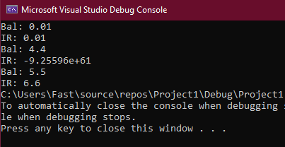
Overloading Parameterized Constructors
int main()
{
BankAccount a = BankAccount();
BankAccount b = BankAccount(4.4);
BankAccount c = BankAccount(5.5, 6.6);
a.showDetails();
cout << endl;
b.showDetails();
cout << endl;
c.showDetails();
}

Slide 19
Copy Constructor
A copy constructor is a member function which initializes an object using another object of the same class.
It follows this prototype:
ClassName (const ClassName &old_obj);
const is a keyword in C++
We use it when we want to keep a value constant
We use it to prevent accidental change to values
Notes:
Over here we’re using const because we’re receiving a reference to the object.
If we accidentally make any changes to the object here, it would be reflected onto the real object!
We can prevent that by using const

Slide 20
Copy Constructor
class BankAccount {
private:
double balance;
double interest_rate;
public:
BankAccount() { //default constructor
balance = 0.01;
interest_rate = 0.01;
}
BankAccount(double _balance) {
balance = _balance;
}
BankAccount(double _balance, double _interest_rate) {
balance = _balance;
interest_rate = _interest_rate;
}
BankAccount(const BankAccount &bankAccount) {
balance = bankAccount.balance;
interest_rate = bankAccount.interest_rate;
}
void showDetails() {
cout << "Bal: " << balance << "\nIR: " << interest_rate;
}
};
Copy Constructor

Slide 21
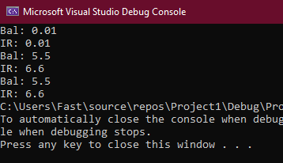
Copy Constructor – How to Use
int main()
{
BankAccount a = BankAccount();
BankAccount b = BankAccount(5.5, 6.6);
BankAccount c = BankAccount(a);
BankAccount d(b);
BankAccount e = d;
c.showDetails();
cout << endl;
d.showDetails();
cout << endl;
e.showDetails();
}

Slide 22
What happens if we remove the const?
When you use const with a function argument, it means the value of that argument cannot be changed inside that function.
In case of copy constructors, it is essential that we do that.
Because we’re passing an object by reference – Any changes made to that reference will be reflected on the original object!!

Slide 23
Why do we need user-defined copy constructors?
In case none is defined, C++ compiler creates a default copy constructor for each class which does a member-wise copy between objects.
But this doesn’t work well when we are working with pointer members, or resources that require dynamic allocation.
We’d prefer a custom copy constructor for these situations.

Slide 24
Shallow Copy | Deep Copy
Shallow Copy:
When you only copy values from one thing to another.
Compiler generated copy constructors only perform shallow copy!

Slide 25
Shallow Copy | Deep Copy
Deep Copy:
Deep copy is possible only with user defined copy constructor.
In user defined copy constructor, we make sure that pointers (or references) of copied object point to new memory locations.

Slide 26
Destructors
Destructor is a member function which destructs or deletes an object.
It is called automatically when:
Object goes out of scope
Function ends
Program ends
Block with local object ends
delete is called

Slide 27
How destructors are different from a normal member function?
Like Constructors, they share the same name as the class
They do not return anything
They do not accept any arguments
Unlike constructors, there can only be one destructor.
Most importantly, they are preceded by a ‘tilde’ symbol. ~

Slide 28
When to write a user-defined destructor?
If we do not write our own destructor in class, compiler creates a default destructor for us.
The default destructor works fine unless we have dynamically allocated memory or pointer in class.
In this case we need to write our own destructor and then deallocate the memory pointed to by the pointed by using the delete keyword

Slide 29
Destructor for our class…
class BankAccount {
private:
double balance;
double interest_rate;
public:
BankAccount() { //default constructor
balance = 0.01;
interest_rate = 0.01;
}
BankAccount(double _balance) {
balance = _balance;
}
BankAccount(double _balance, double _interest_rate) {
balance = _balance;
interest_rate = _interest_rate;
}
BankAccount(const BankAccount &bankAccount) {
balance = bankAccount.balance;
interest_rate = bankAccount.interest_rate;
}
void showDetails() {
cout << "Bal: " << balance << "\nIR: " << interest_rate;
}
~BankAccount() {
cout << "Destructor is called";
}
};

Slide 30
Fin.
: )

